Slide 1


Slide 2

AEROACOUTIC BASED MULTICOPTER UAV IDENTIFICATION AND DETECTION
STUDENT
A/C M HUSNAIN
Total slides : 28
ADVISOR
SL QASIM
CO-ADVISOR
SL IRSALAN

Slide 3
SEQUENCE
Aim of Project
Deliverables
Introduction
Literature Review
Research Gap
Methodology
Current Progress
References
Limitations
Future Tasks

Slide 4

AIM
Design and development of a Quadcopter detection system using Aero-acoustic Signature

Slide 5




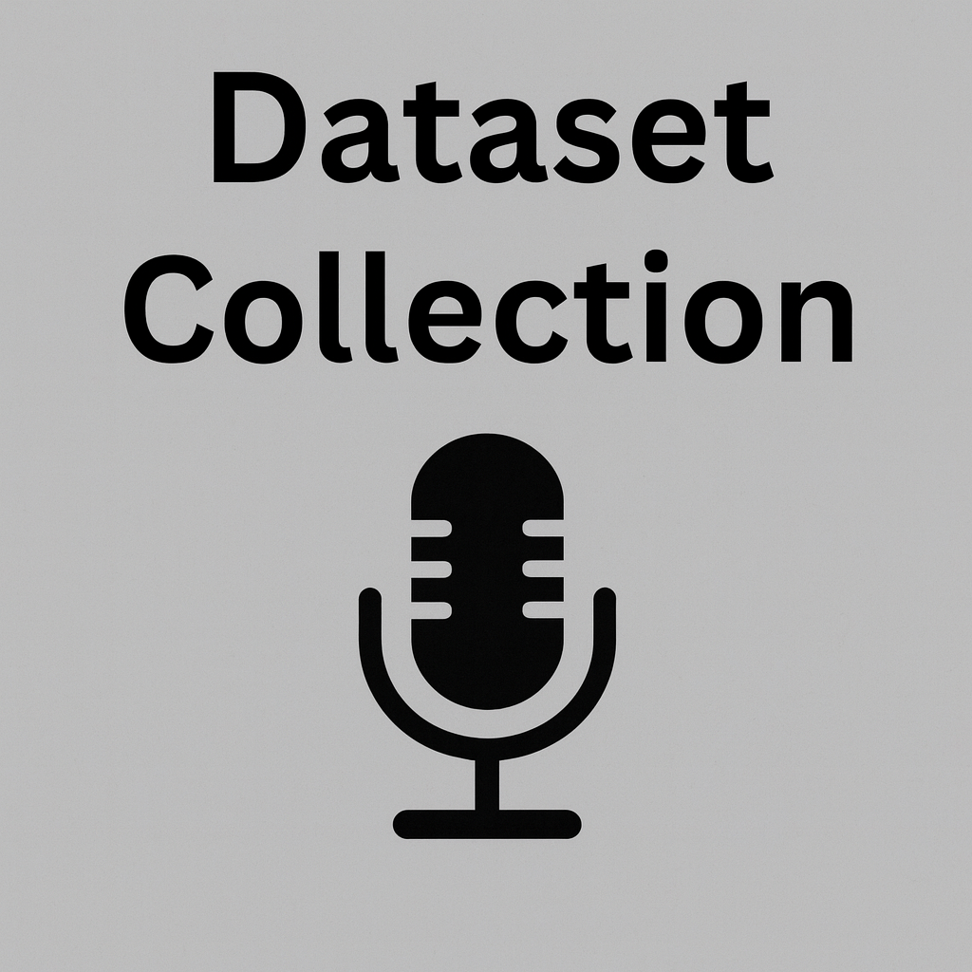

DELIVERABLES
01
02
03
LITERATURE REVIEW
ACQUIRING DATASET
CLASSIFICATION MODEL
Feasibility of Acoustic detection Setup
Benchmarking Techniques
Selection of ML Model
ML model implementation for classification
Online Sourced Dataset
Data Pre-processing

Slide 6


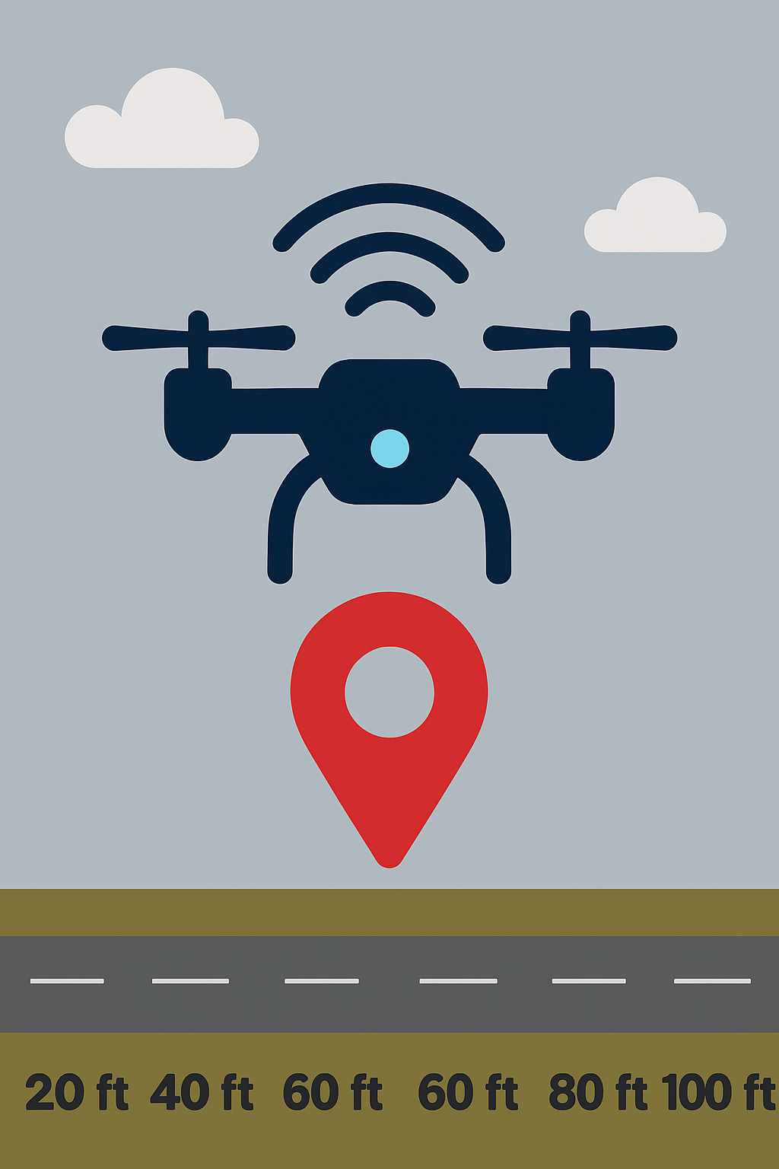
DELIVERABLES
04
05
REAL-TIME DETECTION
DRONE LOCALIZATION
Dataset Collection
Model Implementation
Real time Testing
Dataset development
ML Model Implementation
Real-time testing

Slide 7
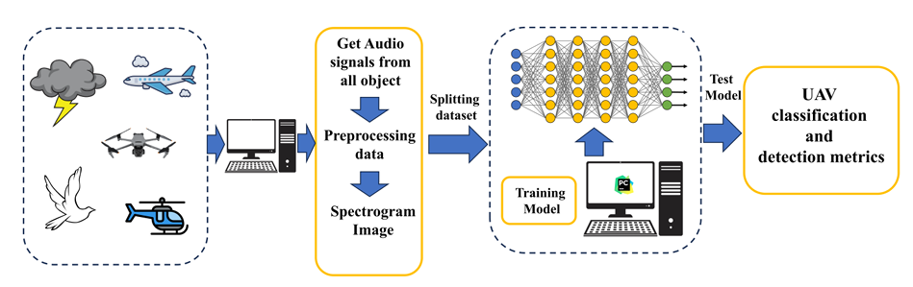
INTRODUCTION
Detection of UAV’s: There are four available methods for detection of UAV’s:
RF based
Visual image based
Acoustic based
Radar signal based
Advantages:
Non-Line of Sight is possible
Range depends on microphone
Low-cost system
Limitation:
Reduce in efficiency in Low SNR regions due to background noise (>30m distance)

Slide 8
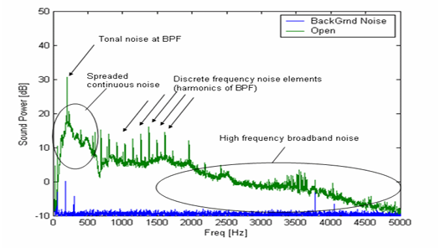
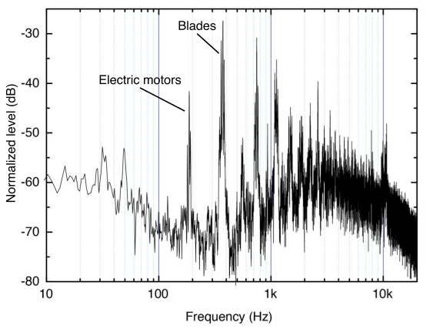
INTRODUCTION
Aero-acoustics of Quadcopter:
In case of UAVs, the propeller is the ‘Dipole Source’ of sound with a “Generic Noise Spectrum” as shown: [9]
We are interested in the following aspects for the identification of UAV’s signature:
Tonal Noise
Discrete Frequency Noise Elements
We can observe similar Noise Spectrum from a Quadcopter as well: [10]
Hence, a Quadcopter has an Aero-acoustic signature that can be used for detection

Slide 9
LITERATURE REVIEW
 | PAPER 1 [1] | PAPER 2 [2] | PAPER 3 [3] | PAPER 4 [4]
TITLE | Audio based drone detection and identification using DL | Development of a new LWCNN for acoustic-based drone detection | Drone detection by acoustic signature identification | Machine learning inspired sound-based drone detection
DATA SET | 1300 drone sound clips 16 KHz , 16 KBps Drone + Noise | 3040 samples Drone + Noise | 4272 samples Drone + Noise | 138 samples
INPUT FEATURE | Spectograms | - | MFCC | MFCC and LPCC
ALGORITHM | CNN, RNN, and CRNN | LWCNN + SVM | SVM | SVM
DRONE | Quadcopter | Parrot Bebop and Mambo | Quadcopter | Parrot Bebop and Mambo
ACCURACY | 96.38%, 75.00%, 94.72% | 94.5% | 97.8% | 97.0%

Slide 10
LITERATURE REVIEW
 | PAPER 5 [5] | PAPER 6 [6] | PAPER 7 [7]
TITLE | Drone detection using convolutional neural networks with acoustic STFT features | Machine learning inspired efficient audio drone detection using acoustic features | A feature engineering focused system for acoustic UAV detection.
DATA SET | 882 samples (20 ms frames with 50% overlap) 44,100 Hz SR | 2664 audio files 44.1 kHz SR Drone + Noise | 600 sound samples and 102.67 min
INPUT FEATURE | Normalization STFT | MFCC | -
ALGORITHM | CNN | SVM | SVM, GNB, KNN, NN
DRONE | Quadcopter | Quadcopter | EVO 2 Pro and a DJI Phantom 4
ACCURACY | 98.97% | 99.9% | 100%, 95.9%, 98.9%, 99.7%,

Slide 11
RESEARCH GAP
Publicly Available Dataset:
There are only two major publicly available datasets
No detail information regarding experimental setup
Relation between the azimuth, distance and altitude of drone from microphone on UAV’s signature is missing
Dataset for Localization:
No any available dataset that can be used for localization

Slide 12
METHODOLOGY
Dataset Collection
Feature Extraction
ML Model Implementation
Real Time Integration
Testing and Validation
Detection and Localization

Slide 13
FEATURE EXTRACTION
Dataset Collection
Python Libraries
.wav files
FFT
Mel Spectograms
SPL
MFCC
Spectograms

Slide 14
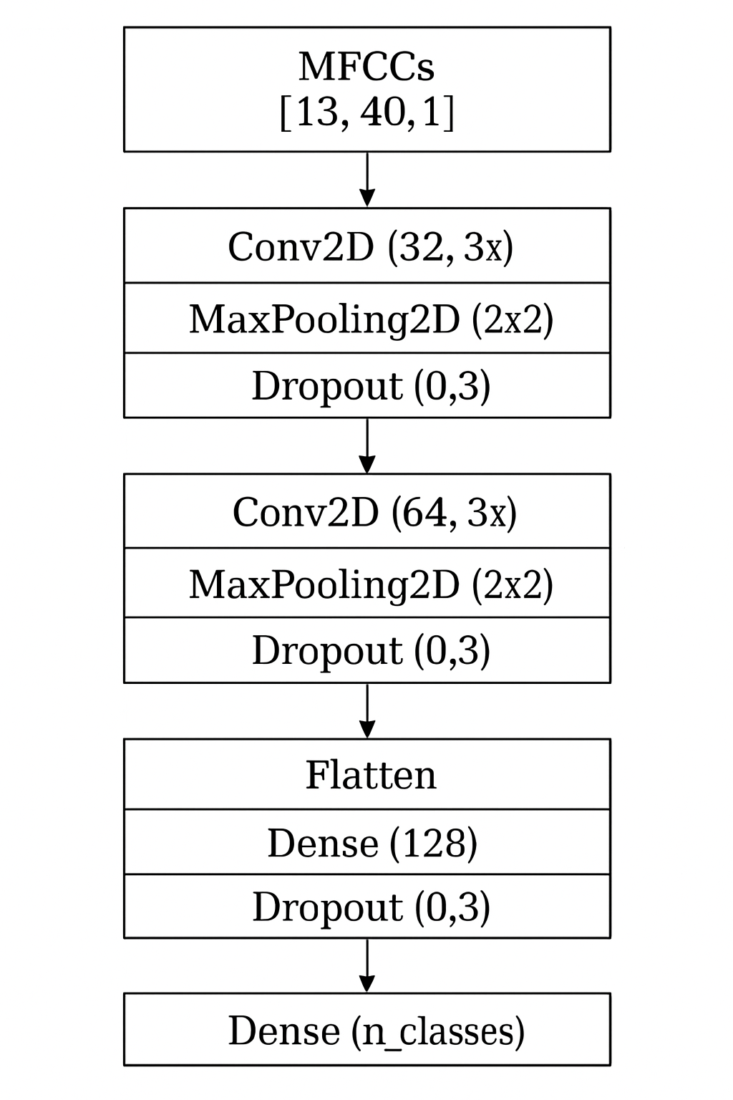
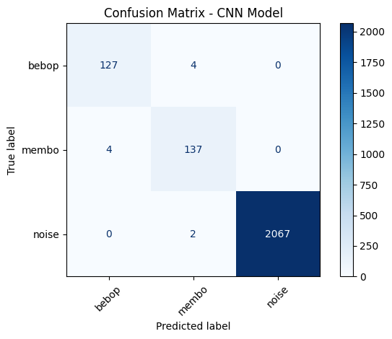
DL MODEL
CNN Model Implementation :
Drones: Parot Bebop , Membo
Sample Rate: 16KHz
Train/Test: 80% - 20 %
Audio Files: 666 Each drone (1 sec) 10,350 Noise files
Input Feature: MFCC’s(13) Audio Files Classification:
Bebop Drone
Membo Drone
Noise
CNN Test Accuracy: 99.57 %
Real-time Detection and Localization?

Slide 15
EXPERIMENTAL SETUP
Microphone Specs
20-20,000KHz
Drone Selection
Quadcopter Tri-blade propellor
Argus 9 Pro Controller
Software Setup
Python Libraries
VS code
Sample:48KHz
Spl: 133dB
USB
Environment

Slide 16
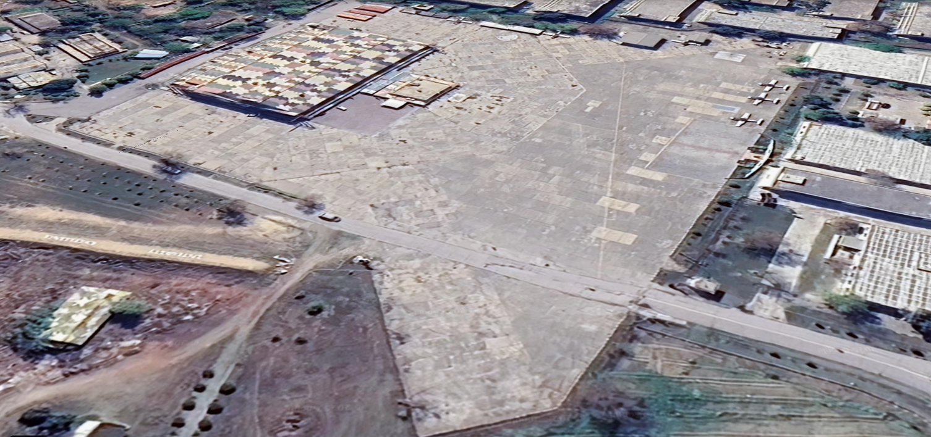
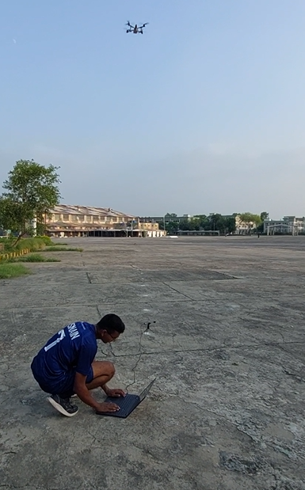
EXPERIMENTAL SETUP
Data Points:
The signature was captured at 20 data points in space for 10 seconds each.
40 ft
30 ft
20 ft
10 ft
100 ft
80 ft
60 ft
40 ft
Mic
20 ft
Mic

Slide 17

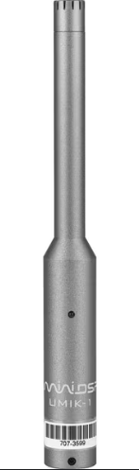
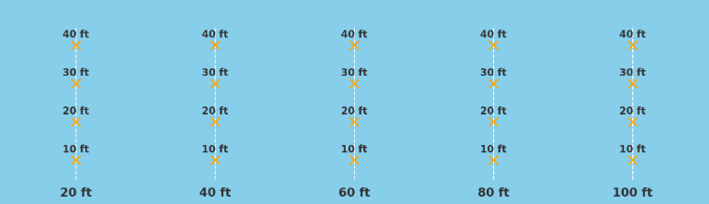
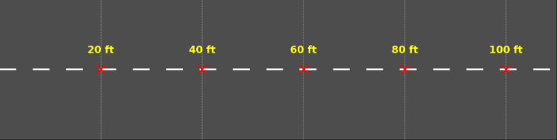
EXPERIMENTAL SETUP
Data Set:
2 mic orientations(0° & 45°) x 5 distances x 4 altitudes = 40 data points
10 sec .wav file. So, 40x 10 = 400 seconds
Schematic Diagram:
Workstation
UMIK-1 Mic

Slide 18
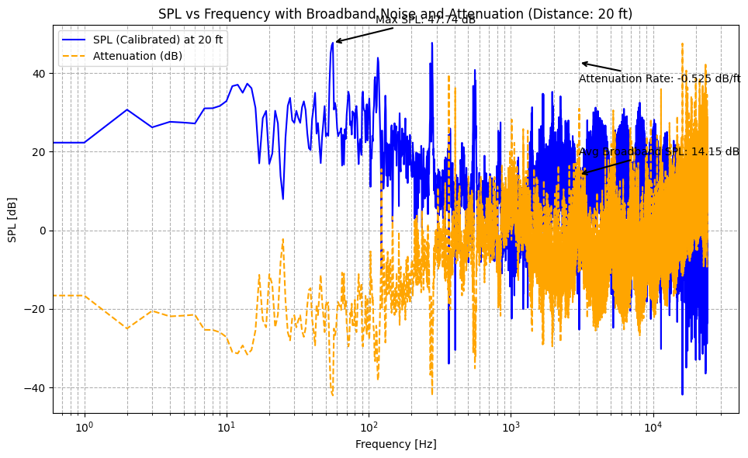
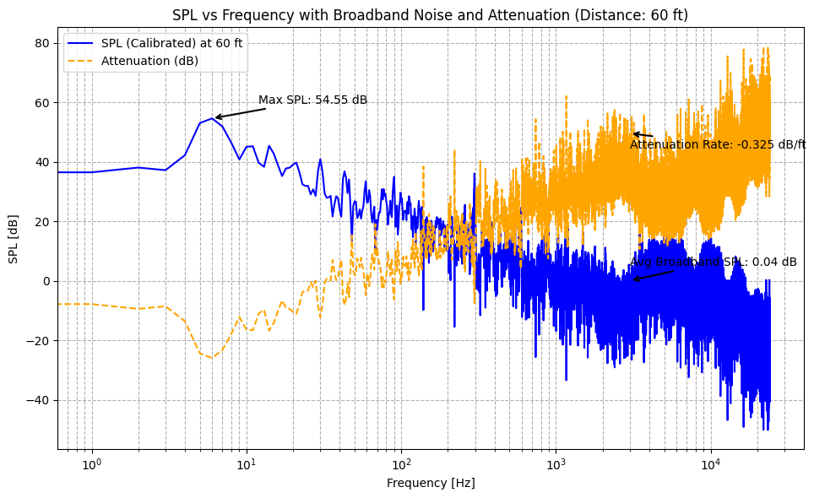
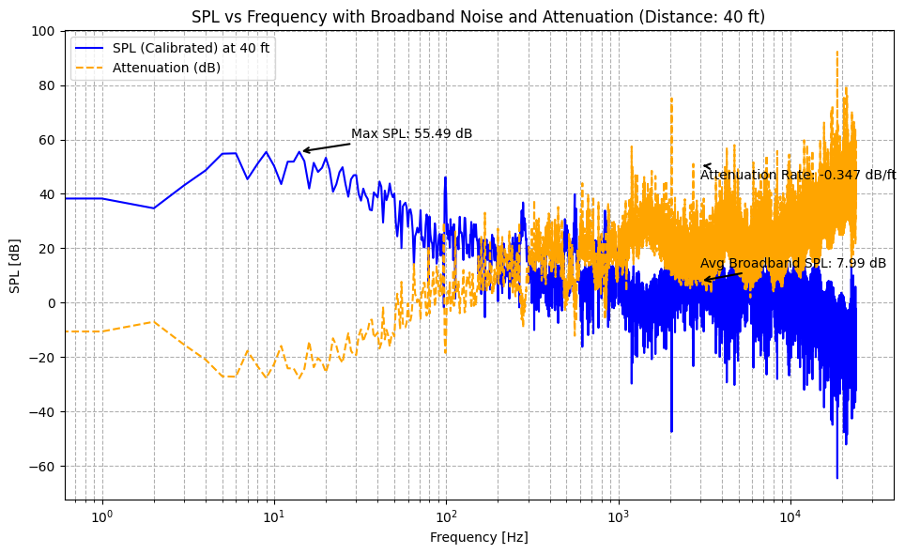
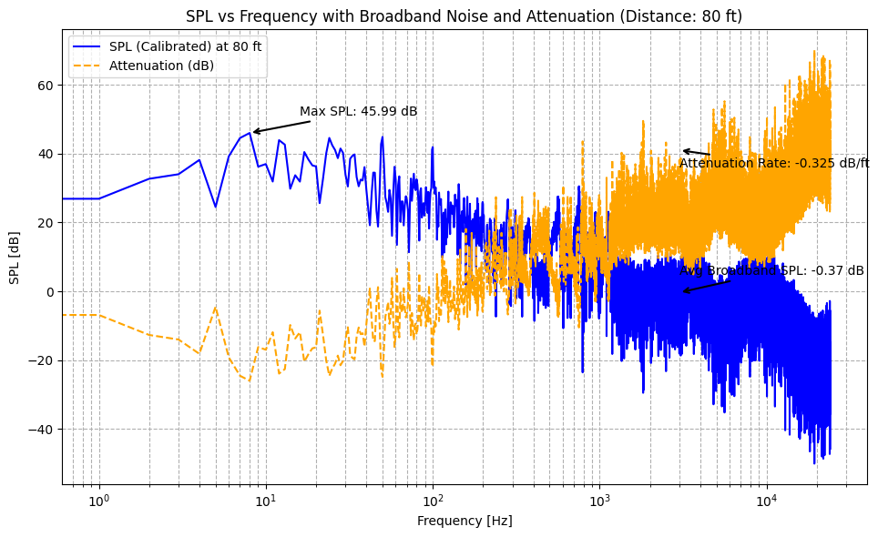
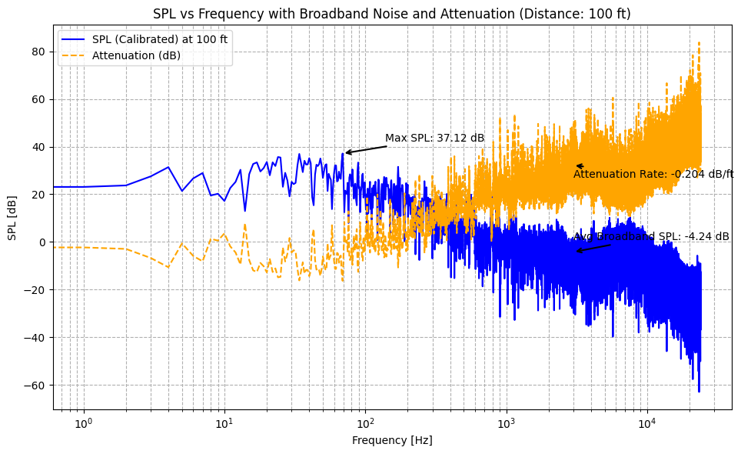
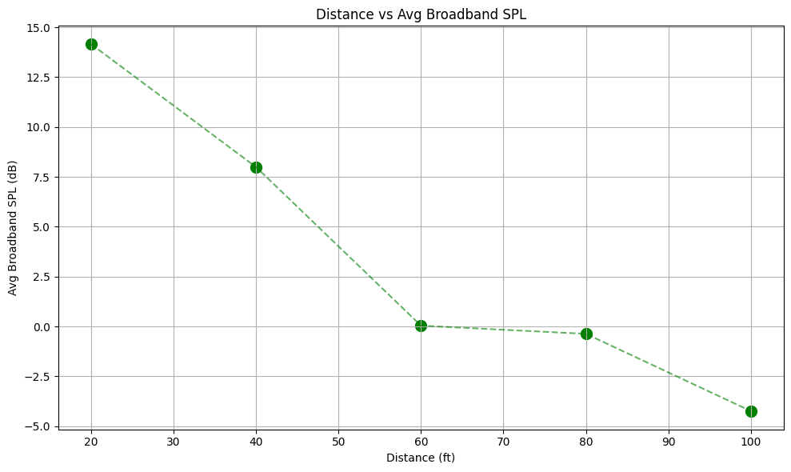
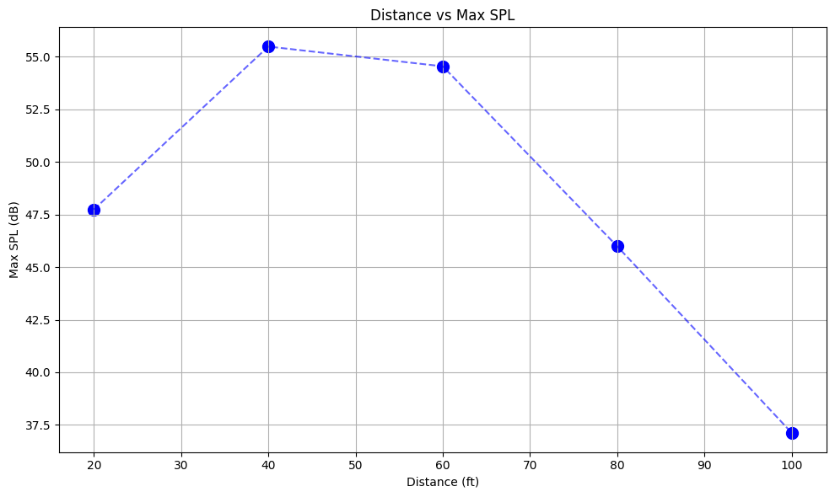
AERO-ACOUSTIC ANALYSIS
SPL vs Frequency Graph:

Slide 19
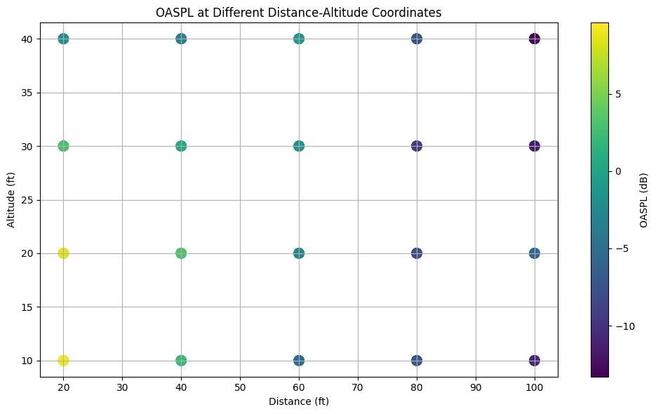
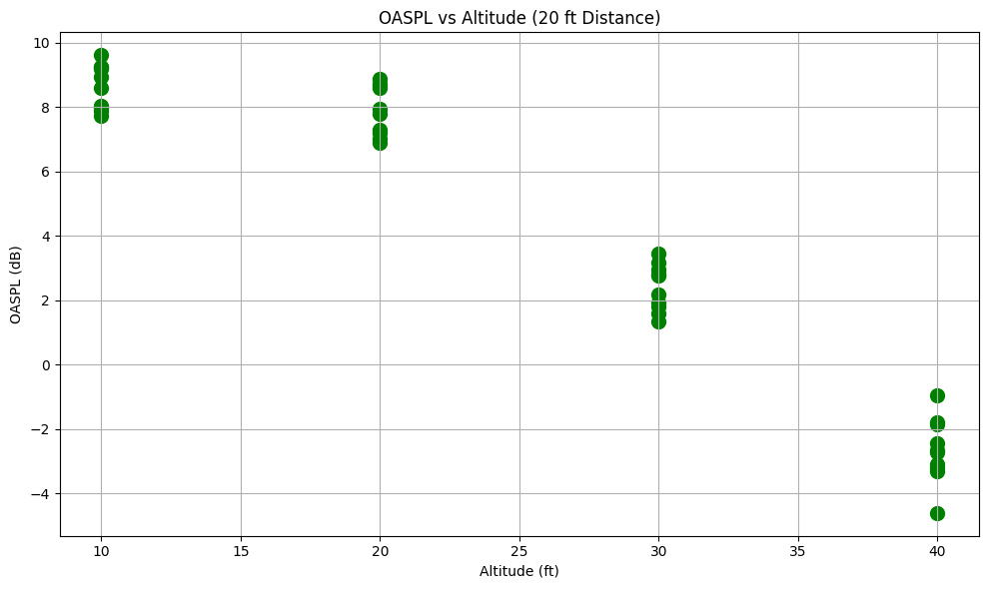
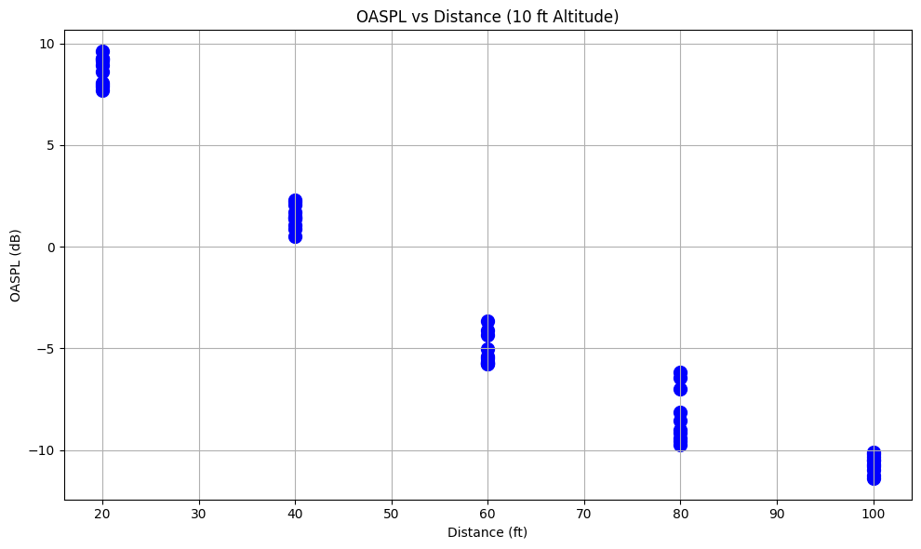
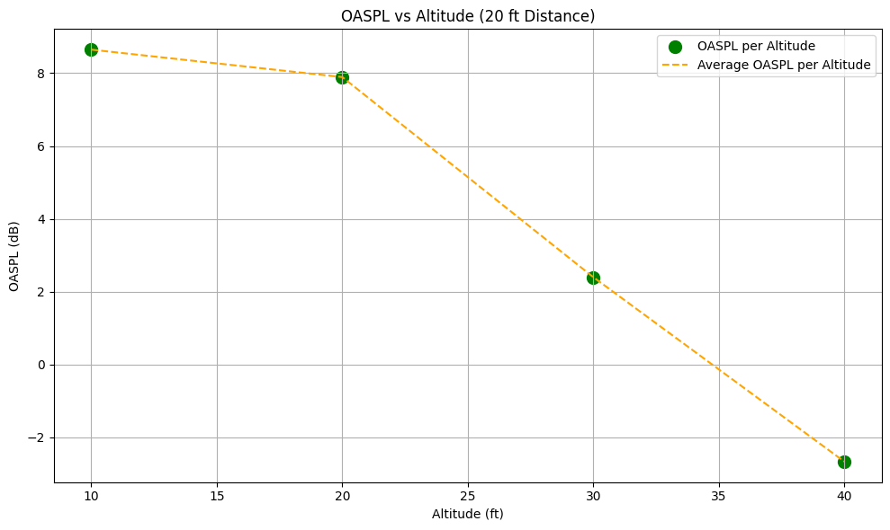
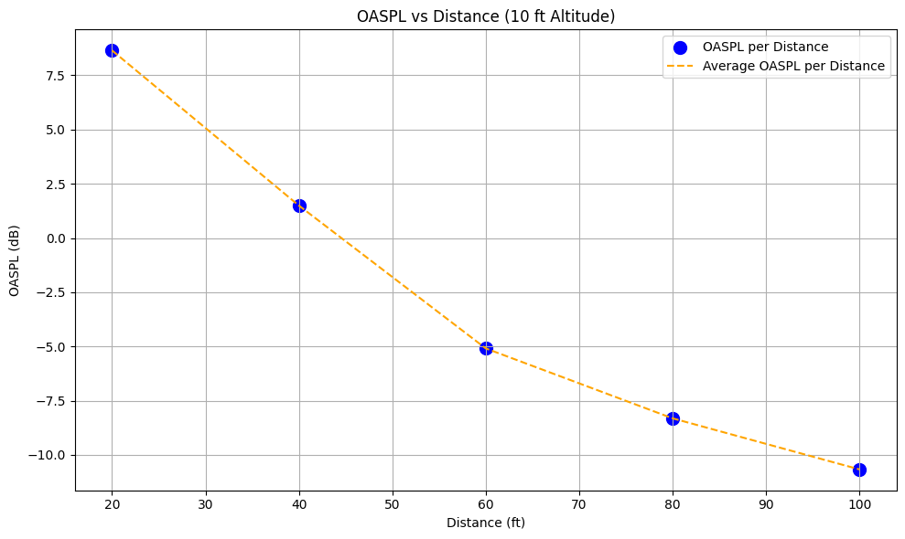
AERO-ACOUSTIC ANALYSIS
OASPL:
The effect of Overall Sound Pressure level at all points in space was studied.
Notes:
The SPL vs Frequency graph and OASPL are two essential tools for characterizing drone noise. Together, they provide a comprehensive understanding of the acoustic signature of drones, which is critical for both design optimization and environmental impact assessment.
Importance of SPL vs Frequency Graph in Drone Noise Characterization
Identification of Tonal and Broadband Noise:
Tonal Noise: The SPL vs Frequency graph can highlight tonal peaks, which are often associated with blade passing frequencies (BPF) or rotor harmonics. These peaks occur due to periodic interactions between the rotor blades and the surrounding air, and they are often a major contributor to drone noise.
Rotor Blade Harmonics: These are discrete peaks at regular intervals on the graph, typically appearing at multiples of the blade passing frequency (BPF). These tonal components are generally highly localized in frequency and can be easily identified in the SPL graph.
Important for noise regulation: Since tonal noise is often more perceptible and annoying to humans, these tonal peaks are critical to measure and characterize.
Broadband Noise: The SPL vs Frequency graph also allows you to detect broadband noise, which is often generated by turbulent airflows or aerodynamic disturbances.
Turbulent Wake and Rotor-Stator Interactions: These contribute to continuous noise across a broad frequency range (e.g., 1 kHz to 10 kHz), which can often be less intense than tonal noise but can still be significant in terms of environmental impact.
Non-periodic Sources: Broadband noise has a more spread-out frequency profile and often shows up as a smoother curve on the graph, indicating the presence of irregular, non-periodic sources of noise.
Frequency Range and Human Perception:
The SPL vs Frequency graph helps to identify which frequency bands contribute most to the overall sound. Human hearing is particularly sensitive to certain frequencies (e.g., 1 kHz to 5 kHz), which means that noise in these ranges is more likely to be heard and perceived as disturbing.
High-Frequency vs Low-Frequency Noise: It is common for high-frequency noise (above 10 kHz) to attenuate quickly with distance, while low-frequency noise (below 500 Hz) tends to propagate farther. This is important when evaluating the propagation of drone noise over distances.
Understanding of Environmental Impact:
Drone Noise Propagation: The SPL vs Frequency graph provides insights into how sound energy is distributed across the frequency spectrum and how it might interact with environmental elements (e.g., buildings, trees, open spaces).
Regulatory Compliance: Many countries have noise regulations for unmanned aerial vehicles (UAVs) that specify allowable noise levels at various frequencies. By analyzing the SPL vs Frequency graph, one can determine if a drone complies with noise pollution standards.
Design Optimization:
Drones are often designed with aerodynamic efficiency in mind, but this can come at the cost of increased noise. By understanding which frequencies are the most dominant in the SPL vs Frequency graph, drone manufacturers can modify designs to reduce tonal noise (by changing rotor designs) or minimize broadband noise (by optimizing airflow and turbulence around rotors).
Importance of OASPL (Overall Sound Pressure Level) in Drone Noise Characterization
Comprehensive Noise Measurement:
OASPL provides a total measure of sound energy emitted by the drone across the entire frequency range (typically from 20 Hz to 20 kHz, the range audible to humans). This makes it a more holistic measure compared to SPL at a single frequency.
Integrating SPL across all frequencies: OASPL accounts for all noise components, including both tonal and broadband noise, offering a global view of the drone's sound profile.
Human Perception of Noise:
OASPL is more reflective of human noise perception because it integrates sound across all frequencies, rather than focusing on just one band. For regulatory and noise control purposes, OASPL gives an overall measure of how loud the drone is from a listener's perspective.
The A-weighting is often applied to OASPL to reflect human ear sensitivity across different frequencies. A-weighted OASPL (often referred to as LAeq) is particularly useful in noise regulation because it mimics human hearing, which is more sensitive to mid-range frequencies.
Environmental Noise Standards:
Many environmental noise regulations or standards (such as those from the FAA or ICAO) require a measurement of the overall sound level of the drone, which is typically provided by OASPL. For example, when drones are operated in urban environments, regulations may specify an OASPL limit to reduce noise pollution.
The OASPL value helps in ensuring that drones are quiet enough for specific zones (e.g., residential or protected areas), considering not just tonal noise but also the spread of noise over all frequencies.
Comparison Across Different Drones:
OASPL allows you to compare the overall loudness of different drones or different flight conditions. It helps to standardize noise levels and provide a single value that represents the total sound emitted by the drone.
When you measure OASPL at various points around a drone or under different conditions, you can better assess how modifications to the drone (e.g., propeller size, rotor speed) affect its overall noise profile.
Impact of Distance on OASPL:
Distance plays a significant role in how the OASPL is perceived. As a drone moves away from the observer, the OASPL decreases due to sound attenuation, especially for high-frequency noise. OASPL measurements at different distances can show how well a drone's noise behaves over longer ranges and is important for understanding how the drone might affect a wider area.
SPL vs Frequency vs OASPL for Drone Noise Analysis
SPL vs Frequency: This graph helps identify specific frequency bands that are problematic in terms of tonal noise and broadband noise.
It's critical for design optimization and understanding the perceptibility of the drone's noise.
OASPL: This provides a holistic measure of how much sound is being emitted by the drone across all frequencies, which is useful for:
Regulatory compliance with noise regulations.
Environmental impact assessments.
Comparison of overall drone loudness.

Slide 20

DATASET
Limitation:
Drone unable to hover at a specific coordinate for longer time
No GPS module integrated in the drone
Small quantity of dataset due to drone battery limitation
Inaccurate drone coordinates labelling
Dataset Manipulation:
Using the dataset to do drone classification
Data cleansing and training
Real time drone detection testing using the available data

Slide 21
DATASET
Data Set | MEMBO | BEBOP | DRONE-A | NOISE
Files | 666 .wav files | 666 .wav files | 400 .wav files (330 .wav files after data cleansing) | 10,400 .wav files
Sample Rate | 16 KHz | 16KHz | 48KHz | 16KHz & 48KHz
Length | 1 sec (Post segmentation) | 1 sec (Post segmentation) | 1 sec (Post segmentation) | 1 sec (Post segmentation)
Source | GitHub | GitHub | Primary Data | Kaggle(10,350) + Primary Data (50)
Coordinates | Unknown (Fixed Location) | Unknown (Fixed Location) | Known (x,y,z) | -
Environment | Indoor | Indoor | Outdoor (Old Parade Square) | Indoor + Outdoor

Slide 22
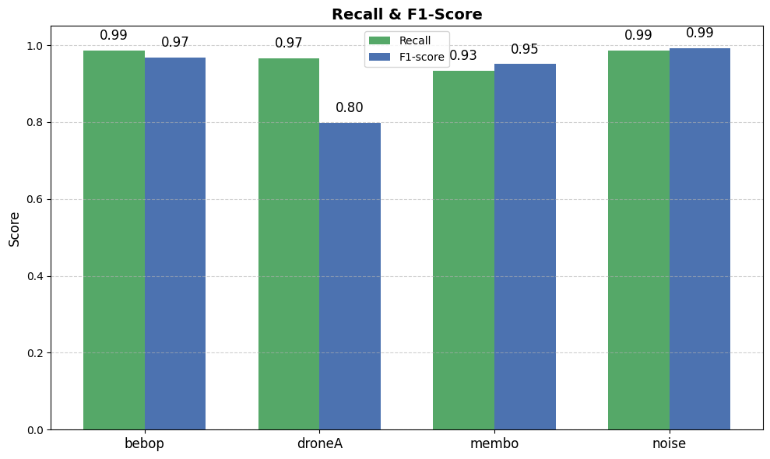
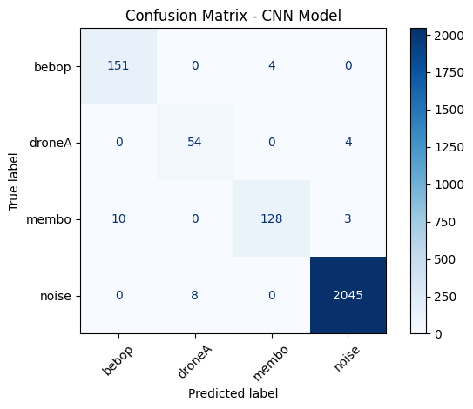
REAL-TIME DETECTION
CNN Model Implementation :
Drones: Bebop, Membo, DroneA
Sample Rate: 16KHz (Forced)
Train/Test: 80% - 20 %
Audio Files: 666 for Membo & Bebop 330 for DroneA
10,400 Noise files
Input Feature: MFCC’s(13) Labels:
Bebop
Membo
DroneA
Noise
CNN Test Accuracy: 98.7 %

Slide 23
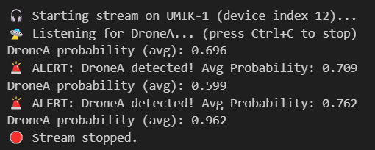
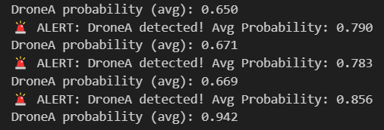
REAL-TIME DETECTION
Python Setup:
Setting up the Visual studio Code for real-time drone detection.
We will use continuous probability variable to detect drone.
An “Alert Message” will be displayed if the probability of the drone is > 0.7
A time step of 0.5 second is analyzed
Enforced sample rate of 16KHz

Slide 24



PROJECT STATUS
DONE
Feature Extraction
Algorithm Selection
Custom Dataset
Aero-acoustic Analysis
Feasibility of Localization
Real-time Detection
IN PROGRESS
Development of setup for acquiring dataset for drone localization
FUTURE TASKS
Acquiring Detailed Dataset for Localization
Lab environment testing

Slide 25
REFERENCES
[1] Aydın, ˙ I.; Kızılay, E. Development of a new Light-Weight Convolutional Neural Network for acoustic-based amateur drone detection. Appl. Acoust. 2022, 193, 108773.
[2] Bernardini, A.; Mangiatordi, F.; Pallotti, E.; Capodiferro, L. Drone detection by acoustic signature identification. Electron. Imaging 2017, 2017, 60–64
[3] Al-Emadi, S.; Al-Ali, A.; Mohammad, A.; Al-Ali, A. Audio based drone detection and identification using deep learning. In Proceedings of the 2019 15th International Wireless Communications & Mobile Computing Conference (IWCMC), Tangier, Morocco, 24–28 June 2019; pp. 459–464
[4] Anwar, M.Z.; Kaleem, Z.; Jamalipour, A. Machine learning inspired sound-based amateur drone detection for public safety applications. IEEE Trans. Veh. Technol. 2019, 68, 2526–2534
[5] Seo, Y.; Jang, B.; Im, S. Drone detection using convolutional neural networks with acoustic STFT features. In Proceedings of the 2018 15th IEEE International Conference on Advanced Video and Signal Based Surveillance (AVSS), Auckland, New Zealand, 27–30 November 2018; pp. 1–6.
[6] Salman, S.; Mir, J.; Farooq, M.T.; Malik, A.N.; Haleemdeen, R. Machine learning inspired efficient audio drone detection using acoustic features. In Proceedings of the 2021 International Bhurban Conference on Applied Sciences and Technologies (IBCAST), Islamabad, Pakistan, 12–16 January 2021; pp. 335–339.

Slide 26
REFERENCES
[7] Wang, Y.; Fagian, F.E.; Ho, K.E.; Matson, E.T. A feature engineering focused system for acoustic uav detection. In Proceedings of the 2021 Fifth IEEE International Conference on Robotic Computing (IRC), Taichung, Taiwan, 15–17 November 2021; pp. 125–130
[8] M. H. Rahman, M. A. S. Sejan, M. A. Aziz, R. Tabassum, J.-I. Baik, and H.-K. Song, "A Comprehensive Survey of Unmanned Aerial Vehicles Detection and Classification Using Machine Learning Approach: Challenges, Solutions, and Future Directions," Remote Sensing, vol. 16, no. 5, p. 879, Mar. 2024, doi: 10.3390/rs16050879.
[9] S. Q. Zaheer, M. A. Khan, and M. S. Khan, "Generalised Modelling of Sound Signatures for Characterization of Multi-copter Unmanned Air Vehicles based on Aero-acoustics Measurements and CFD Analysis," in 2021 Seventh International Conference on Aerospace Science and Engineering (ICASE), Islamabad, Pakistan, 2021, pp. 1–6, doi: 10.1109/ICASE53582.2021.9677022.
[10] I. Djurek, A. Petosic, S. Grubesa, and M. Suhanek, "Analysis of a Quadcopter’s Acoustic Signature in Different Flight Regimes," IEEE Access, vol. 8, pp. 10662–10670, 2020, doi: 10.1109/ACCESS.2020.2965177.

Slide 27
THANK YOU

Slide 28
QUESTIONS

